Slide 1
KP CANISTER FULL INVESTIGATION
NOC: PRB -68

Slide 2
Issue Definition
What We Know

Slide 3
Issue Definition
Canister full error is a message a number of customers are encountering on different KPs across the network despite not having filled their canisters to the 2.3L threshold.
Manifests in 2 different ways
Customer gets Canister full alert for a canister that is completely empty
Customer starts dispensing but the dispense is prematurely terminated at very low levels in the canister

Slide 4
What We Know
Numbers for the period 3/17/2020 to 3/18/2020
Total number of dispenses | 5060
Total number of status code 3 | 1135
Count of status code 3 where dispensed amount >1799 ml | 559
Count of status code 3 where dispensed amount = 0ml | 473
Count of customers with status code 3 | 703
Count of customers with status code 3 & amount = 0ml on 3/17 | 71
Count of customers with status code 3 & amount = 0ml on 3/18 | 60
KPs affected with amount =0ml on 3/17 | 8
KPs affected with amount =0ml on 3/18 | 10
Repeat KP cases | 1

Slide 5
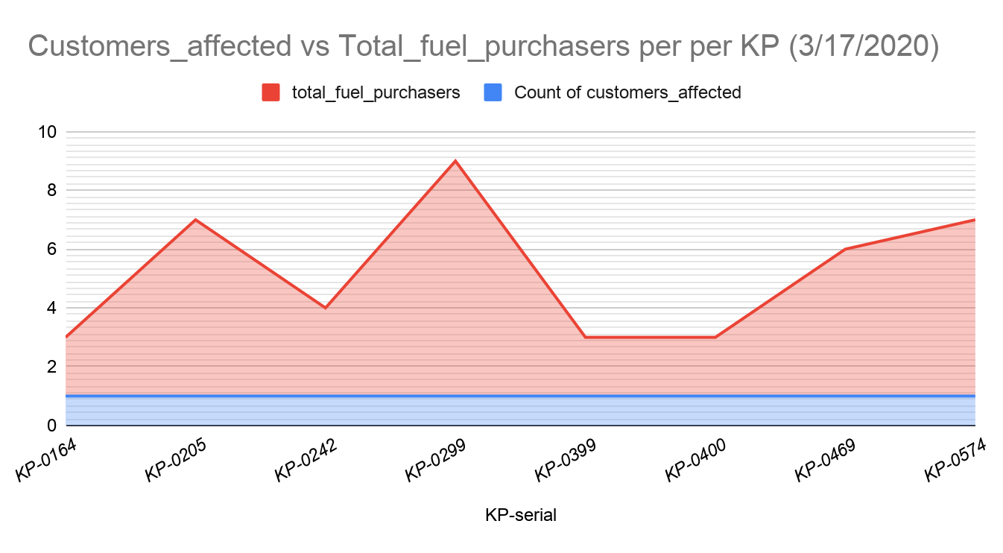
What We Know

Slide 6
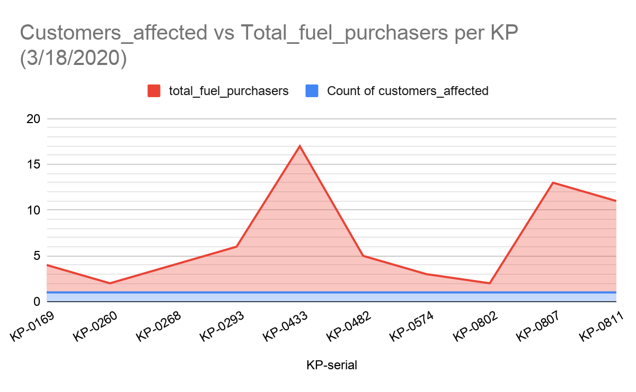
What We Know

Slide 7
What We Know
From the sample data presented over the two days in slide 5 and slide 6, it is evident that:
The issue is spread across numerous KPs per day
There was only 1 repeat KP case
A small number of customers <=3 cause the majority of issues per KP per day

Slide 8
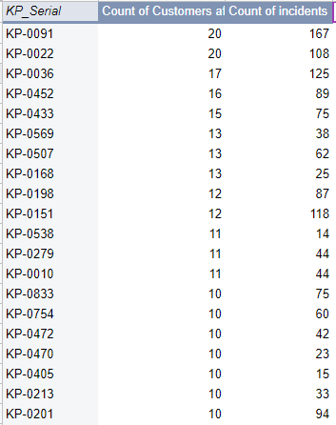
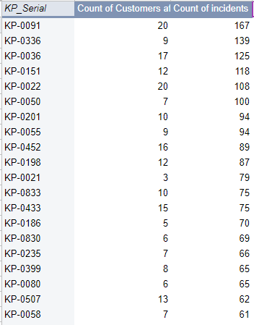
What We Know
Top 20 KPs By Customer Count in March
Top 20 KPs By Incident Count in March
463 KPs had status code 3 with 0 ml dispensed in March
20 KPs had >=10 customers affected
347 KPs had <=5 customers affected
136 KPs had 1 customer affected

Slide 9
Important Observations
19 customers sampled across 3/15/2020 to 3/25/2020:
First-time issue = 10 customers
Recurring issue = 9 customers
24 of 247 customers listed in the Customer Care Issue Discovery sheet between 3/15/2020 to 3/30/2020 had sent someone to the KP on the incident day
8 of the 24 specifically sent a child
5 of the customers reported to have sent a child were experiencing a first-time issue
The recurring issues where a customer sent a child involved several failed attempts over a period of up to 15 minutes, e.g the two below:
George Muchiri on 2/15/2020, 3/15/2020 & 3/27/2020
Richard Thuku on 3/1/2020, 3/3/2020 & 3/15/2020
Whether someone else (especially children) goes to purchase fuel is an important factor since it
plays to whether the guidelines given to customers by Customer Care actually gets to the target
user.

Slide 10
Longer Term Investigation Observations
Below some resolutions that worked for customers we investigated over the past 2 months
Resolution | Count of customers
Canister replacement | 6
CF sensor adjustment | 1
Dock alignment | 1
Canister depressurization | 1
CF sensor replacement | 1
KP change | 1
Pending | 2

Slide 11
Canister Retrieval Observations
Below a summary of canisters that have been targeted for retrieval:
Category | Count
Total listed | 25
Total retrieved | 17
Total tested | 14
Total issue reproduced | 1
Total untraced | 3
Total pending tests | 0
The maintenance team were unable to reproduce the issue even for the customer who mentioned he had to hold his canister backward to dispense successfully
The customers whose canisters were retrieved have been able to dispense successfully with the new canisters

Slide 12
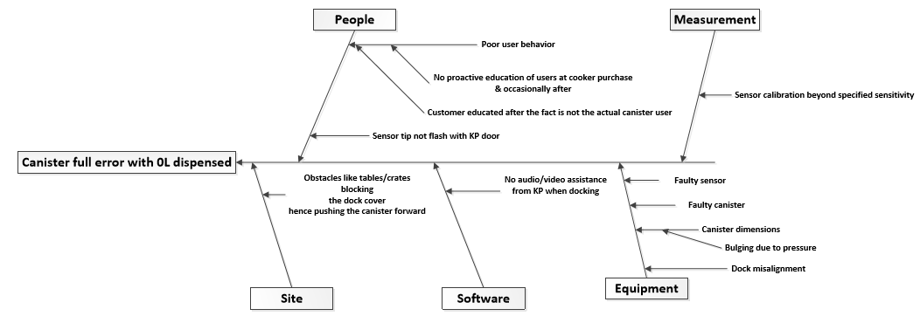
Canister Full Error Fishbone Analysis

Slide 13
Prioritization Matrix for Root Causes
Root Cause | Likelihood of occurrence | Severity | Ease of detection | Cumulative scale
Dock misalignment | 4 | 5 | 3 | 60
Sensor calibration beyond specified sensitivity | 3 | 5 | 3 | 45
No proactive education of users at cooker purchase and after | 4 | 5 | 2 | 40
Faulty sensor | 2 | 3 | 5 | 30
Faulty canister | 2 | 3 | 5 | 30
Sensor tip not flash with KP door | 2 | 5 | 2 | 20
Obstacles like tables/crates blocking the dock cover | 2 | 5 | 1 | 10
Bulging canister due to pressure | 2 | 2 | 1 | 4
Rating | Likelihood/Severity/Detection
1 | Impossible/Very low/Very high
2 | Unlikely/Low/High
3 | Even chance/Moderate/Moderate
4 | Likely/High/Low
5 | Certain/Very high/Very low
Canister Full Tickets on Freshservice

Slide 14
Recommendations and Next Steps
Next steps
QC checks for dock alignment to be introduced after dock assembly and after every dock replacement activity in the field
NOC to coordinate the visit of KPs with repeat CF issues (from a list of 396) that meet the criteria defined
In-house investigations on sample replaced sensors for establishment of possible fault
Recommendations
Customer sensitization on docking Dos and Don’ts during cooker fulfillment
Instructional docking videos (guiding on how to avoid CF) be incorporated in the KP customer interface
Agent sensitization on impact of obstacles in front of KPs on customer dispense
Addition of user phone contact into the customer account details for customer care to have access to actual users for ease of issue troubleshooting

